Slide 1
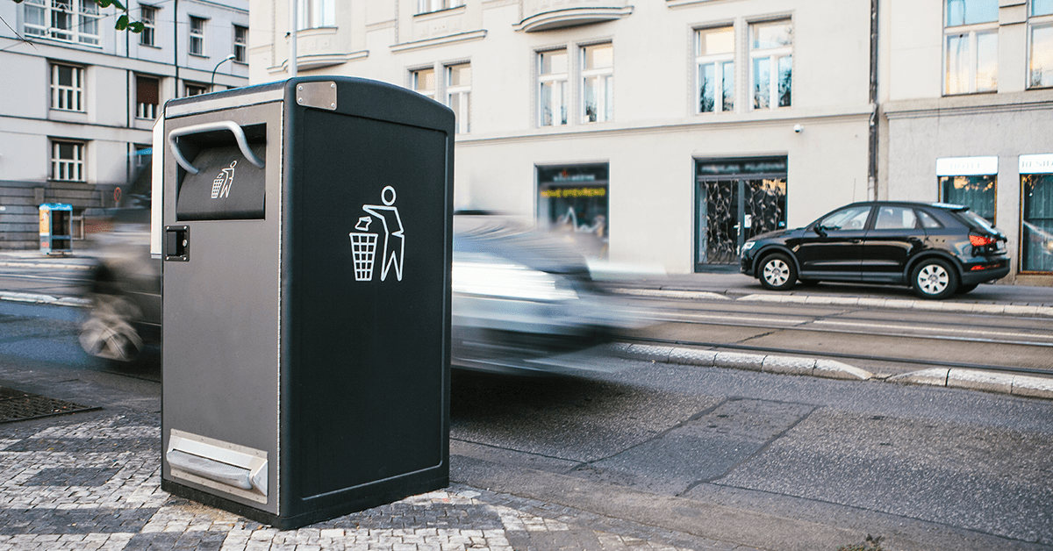
Stock-loss Prevention
Background Knowledge Sharing
- AI -
Team E
Borislav Pavlov, Young Oh Kim, Geo Ryang Park, Min Jae Kim
Capstone Design_SWE3028-41

Slide 2
Index
Current situation
What CNN is
Model in our Project
How CNN works
- Use of residual connection
Unique role in our application of CNN for alarm

Slide 3
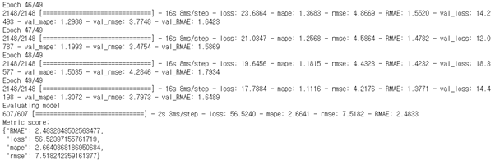
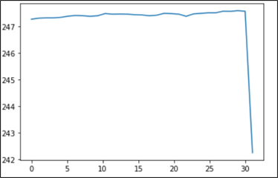
Current Situation
→ Training with best epoch,
Predict stock price after 1min
We tried to use the CNN-LSTM fusion model
Performance is not as expected and the code is too complicated to fix
Decided to make own model with CNN
Currently only CNN model, but we consider about LSTM or RNN later.
→ Real stock price
for 30 min
→ Result with
predicted value
→ Predicted stock price

Slide 4
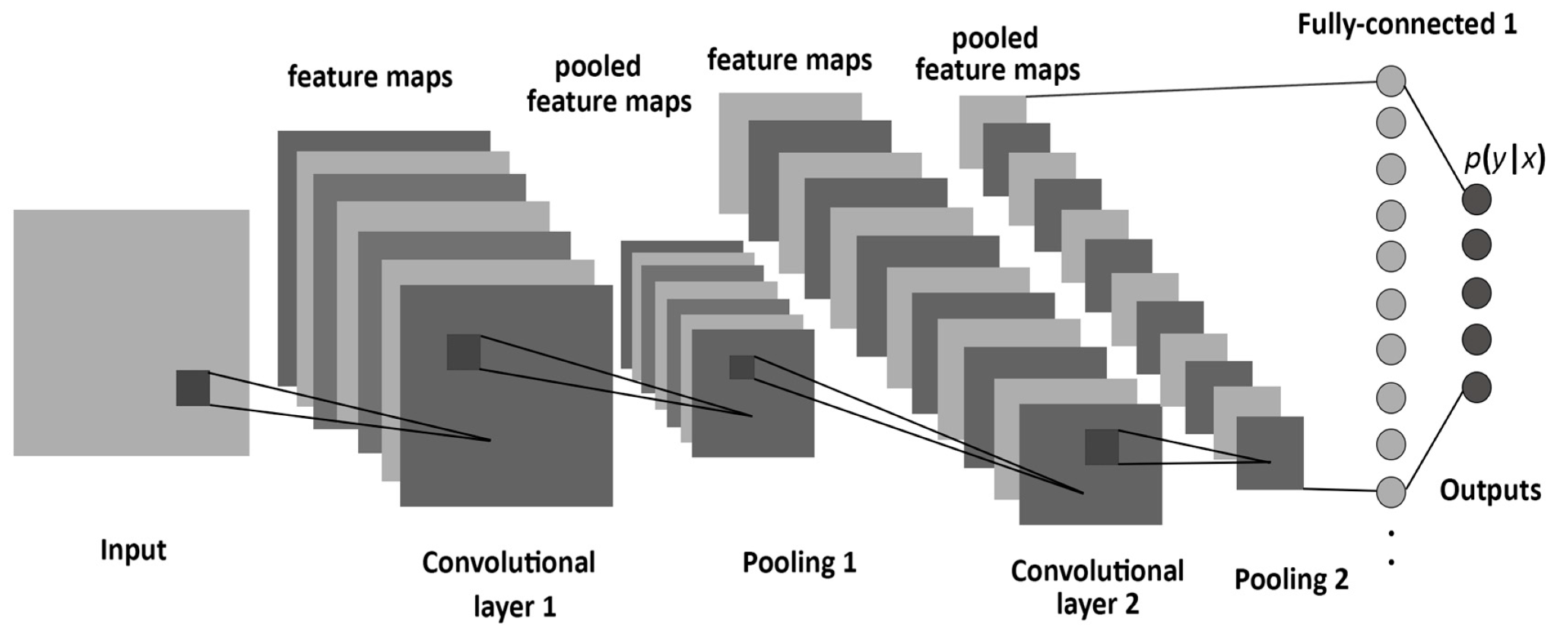
What CNN is
CNN : Convolutional Neural Network
- Neural network with Convolutional layer
- Specialized in image learning

Slide 5
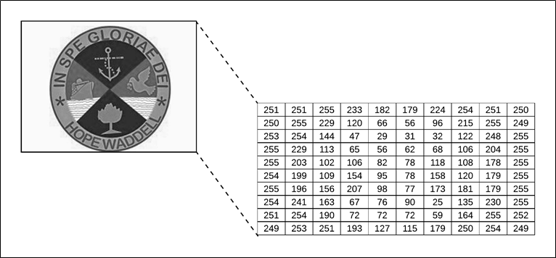
What CNN is
Input preprocessing
→ Image to Array
→ Array(Img_width, Img_height, 3)
(3 for RGB)

Slide 6
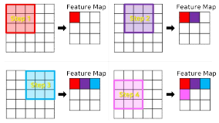
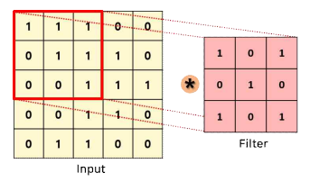
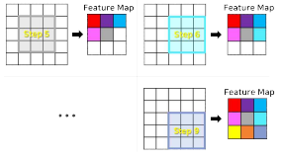



What CNN is
Convolution Operation
- Convolution operation
between input and filter(=kernel)
x
=

Slide 7
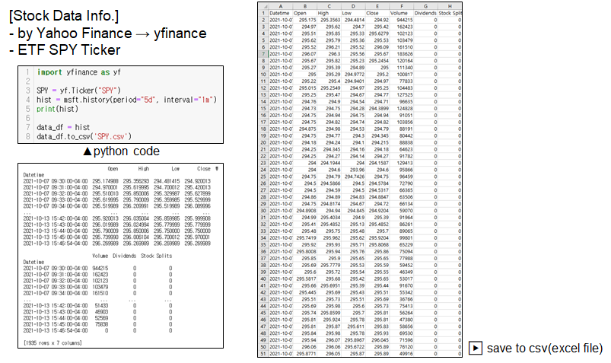
Model in our Project

Slide 8
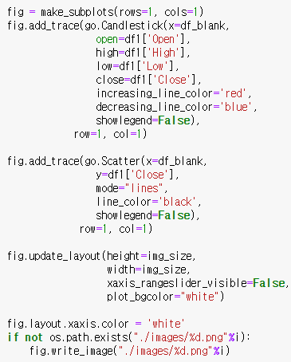
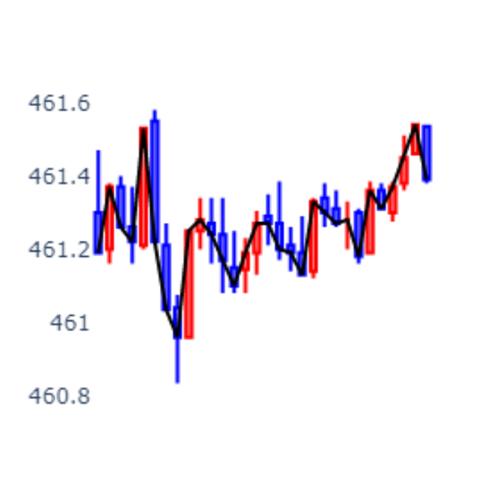
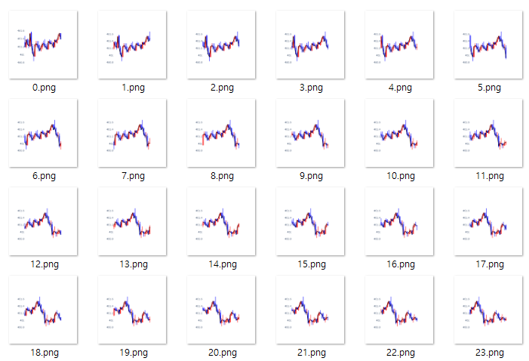
Model in our Project
Input Data
Minute-by-minute data
(30min)

Slide 9
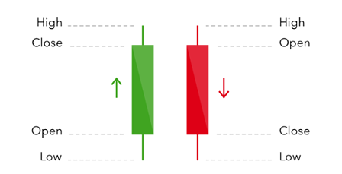
Model in our Project
Input Data
Graph that connects close price

Slide 10
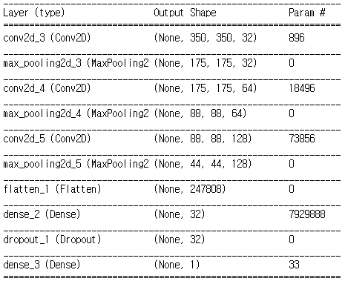
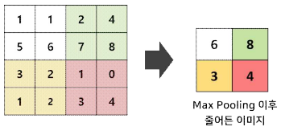
Model in our Project
CNN Model
- Total 10 layers
- Input shape : (1900, 350, 350, 3)
- Kernel size : 3 x 3
- Max pooling
- Dropout(0.2) at fully-connected
- Optimizer : Adam
- Loss : mse
- Metrics : mse, mae
Max pooling

Slide 11
Model in our Project
Input : (dnum, 350, 350, 3)
Output : (dnum,1) (1min after 30min, “31”)
Need 2 arrays to store
→ arr1
: Store difference between high and low (466.425 - 466.27)
→ arr2
: Store Average of High and Low
(466.425+466.27) / 2
(arr2 used for regression value)
High
Somewhere
close price
Low
(for 30min, “0~30”)
Predict the average of high and low + using the value stored in arr1
→ Result of predicting two values, high and low, with one value

Slide 12
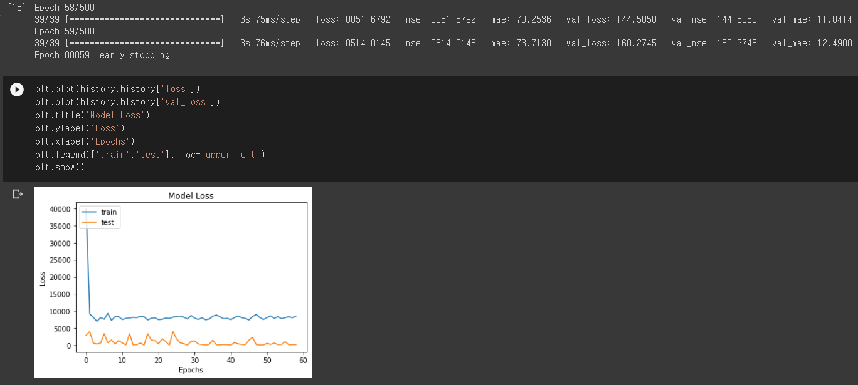
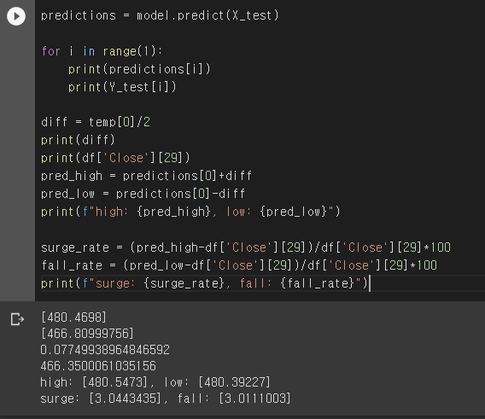
Model in our Project

Slide 13
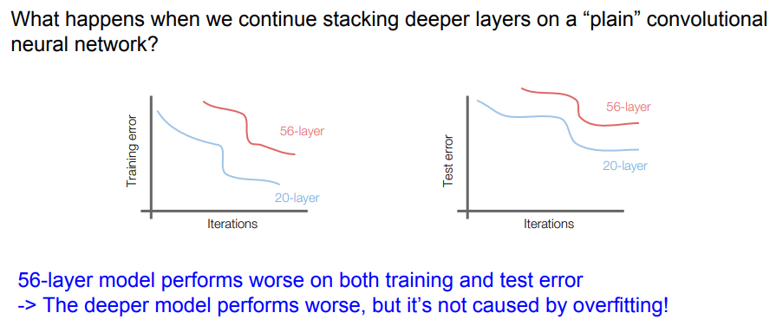
Use of Residual connection in order to improve CNN performance
from [4]

Slide 14
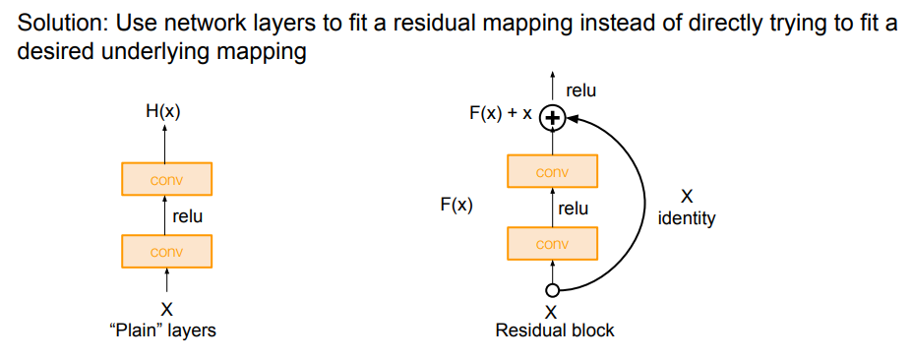
Use of Residual connection
from [4]

Slide 15

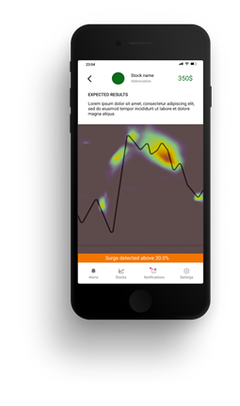
Unique role in our application for alarm
The reason we prefer CNN over transformer or LSTM lies in the assumption that it can be used for visualization including heatmaps.
original goal

Slide 16
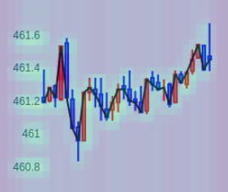
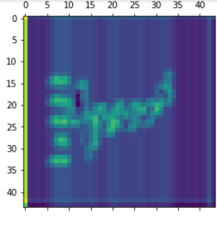
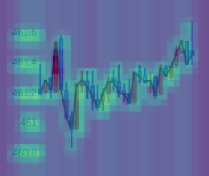
Unique role in our application for alarm
gradCAM
Overlap 2 firgures and
adjust color intensity.

Slide 17
References
[1] CNN, Busan Digital University ,http://contents2.kocw.or.kr/KOCW/data/document/2020/edu1/bdu/hongseungwook1118/041.pdf
[2] CNN, https://cs231n.github.io/convolutional-networks/
[3] Residual Networks, https://d2l.ai/chapter_convolutional-modern/resnet.html
[4] Residual Networks, http://cs231n.stanford.edu/slides/2017/cs231n_2017_lecture9.pdf

